Slide 1

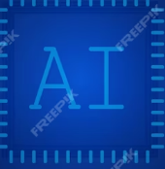
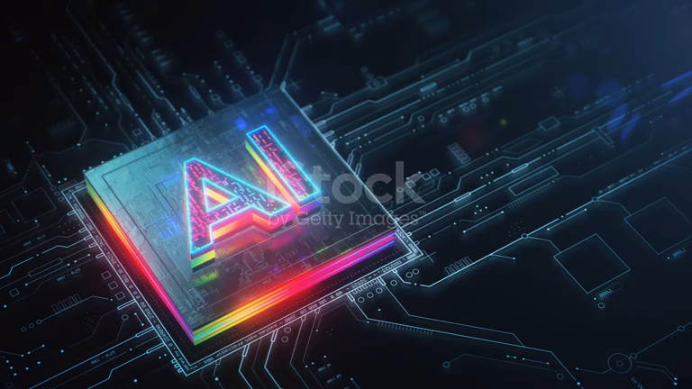
Artificial Intelligence
Presented By : Group 1
Members : FeezaKulsoom
Roll No : 03

Slide 2
Introduction to AI
Definition:
AI enables machines to mimic human intelligence, learning from data to perform tasks like decision-making and language processing.
Real-World Impact:
Healthcare: AI assists in diagnosing diseases (e.g., IBM Watson).
Finance: Fraud detection and automated trade (e.g., AI in banking).
Transportation: Self-driving cars (e.g., Tesla Autopilot).
Education: AI tutors (e.g., ChatGPT).

Slide 3
Hands-On Experiment with ChatGPT
Tool Used:
ChatGPT : AI-Powered Language Model by OpenAI.
Experiment Conducted:
Asked AI to explain AI, generate a story, summarize an article, and translate text.
Observations:
AI provides fast, accurate responses, but may have biases.

Slide 4
Challenges & Future of AI
Challenges:
Job Replacement: Automation reduces manual labor jobs.
Bias & Ethics: AI can reflect biases in training data.
Transparency Issues: Hard to explain AI decision-making.

Slide 5
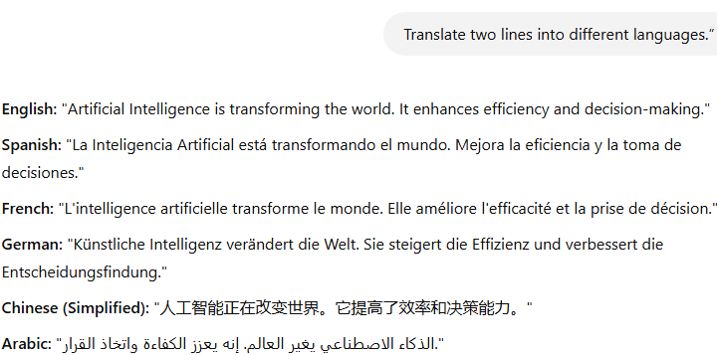
Key Learning:
AI improves productivity in education, business, and creative tasks.
Figure No 1: Interaction with AI

Slide 6
Future Potential:
AI + Quantum Computing :Faster problem-solving.
AI in Healthcare : Personalized medicine & robotic surgery.
General AI : Machines with near-human intelligence.
“AI will not replace humans, but humans who use AI will replace those who don’t.”

Slide 7
Final Thoughts:
AI is revolutionizing industries with automation and intelligence.
Ethical challenges must be addressed for responsible AI growth.
AI’s future will shape how humans interact with technology.

